Slide 1
THE PRAGMATIC THEORY OF THE FIRM
Bartley J. Madden
Madden Center for Valuation Creation
Florida Atlantic University

Slide 2
FOUR ESSENTIAL CRITERIA FOR EVALUATING
A THEORY OF THE FIRM
  Facilitates systems thinking
  Clarifies the purpose of the firm
  Identifies the critical determinant of the firm’s long-term performance
  Connects the firm’s long-term performance to market valuations and shareholder returns

Slide 3
STARTING POINT – THE FIRM’S PURPOSE
Communicate a vision
Survive and prosper
Sustain win-win relationships
Take care of future generations
Maximizing shareholder value is the result of achieving four-part purpose

Slide 4
BEST PERFORMING LARGE BANK DURING 2008 CRISIS
BB&T CEO JOHN ALLISON
“If you want to have passion and energy in your life, you must have a sense of purpose in your work … I ask the employees of BB&T: Are you truly making the world a better place to live through your work? Are you really helping your clients achieve economic success and financial security? Are you providing the quality of advice that ensures that they make better decisions?
You should never do anything that you believe will not be in your client’s best interests, even if you can make a profit in the short term … Life is about creating win-win relationships.”
Allison (2013) p. 241

Slide 5
COMPONENTS OF THE Pragmatic Theory of the Firm
KNOWLEDGE
BUILDING
CULTURE
SHAREHOLDER
RETURNS
WORK
FIRM’S
PURPOSE
LIFE-CYCLE
FRAMEWORK
INNOVATION
FIRM RISK
RESOURCE
ALLOCATION

Slide 6
life-cycle STAGES AND MANAGEMENT PRIORITES
High
Innovation
Failing
Business
Model
Competitive Fade
Mature
FADE
%
Long-term
Cost of
Capital
Economic Returns
Reinvestment
Rates
Purge
Business-
as-Usual
Culture and
Restructure
the Firm
Do We Deliver
a High-Value
Experience
to Customers?
Build or Acquire
New Capabilities
to Accelerate
Innovation
Improve
Efficiency While
Developing
New Businesses

Slide 7
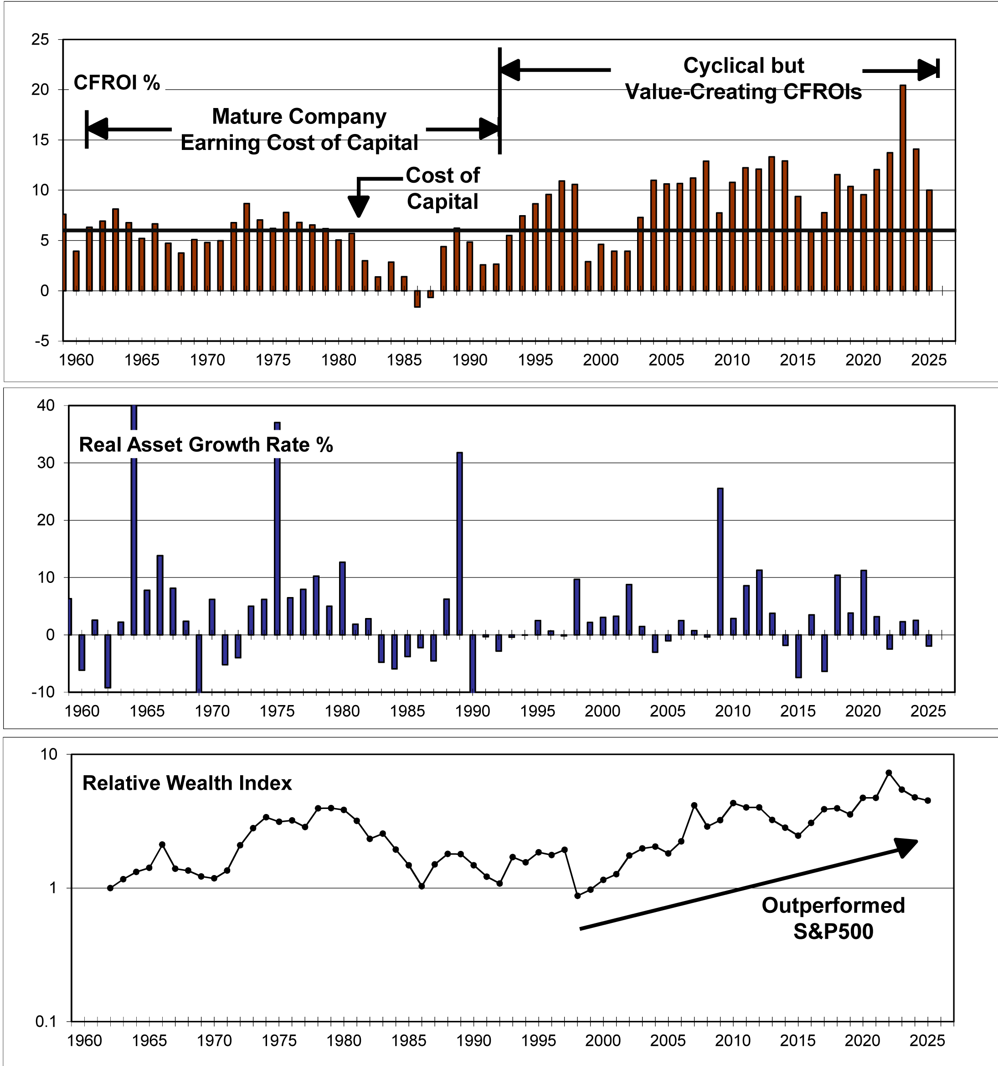
DEERE 1960 to 2025
Source: UBS HOLT global database.

Slide 8
COMPONENTS OF THE Pragmatic Theory of the Firm
KNOWLEDGE
BUILDING
CULTURE
SHAREHOLDER
RETURNS
WORK
FIRM’S
PURPOSE
LIFE-CYCLE
FRAMEWORK
INNOVATION
FIRM RISK
RESOURCE
ALLOCATION

Slide 9
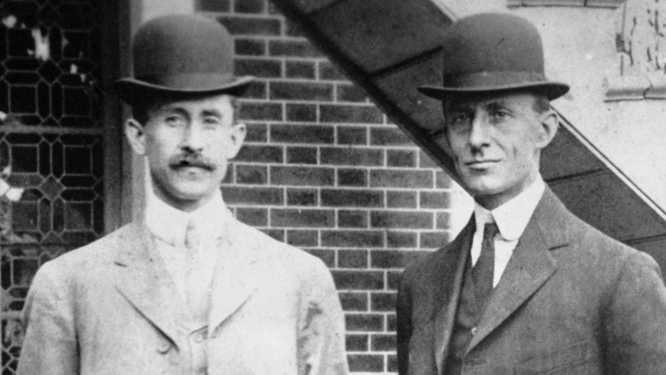
Orville and Wilbur Wright, 1903,
TAUGHT THE WORLD HOW TO FLY
We need a better way of analyzing the knowledge-building process

Slide 10
The Knowledge Building Loop
SYSTEMS THINKING LANGUAGE
ASK BETTER QUESTIONS
PERCEPTIONS
WORLDVIEW
ACTIONS AND
CONSEQUENCES
PURPOSES
FEEDBACK
KNOWLEDGE
BASE
Notes:
10

Slide 11
IMPORTANT TAKEAWAYS
  FOUR-PART PURPOSE
    Vision
    Survive and Prosper
    Win-win Relationships
    Future Generations
  Pragmatic Theory of the Firm Facilitates Systems Thinking
  Life-Cycle Framework
    Connects Performance Measurement, Management Priorities, and Resource Allocations
  Knowledge Building Culture is Key Determinant Long-Term Performance

